Slide 1
MODULE 4

Slide 2
Wired LANs: ETHERNET
LAN is used for a limited geographical area.
To solve the issues related to media sharing was handles using CSMA/CD approach.
Number of technologies other than Ethernet came into existence. (Eg: ATM LAN)
Only Ethernet survived.
It could evolve with the demand for higher transmission rates.

Slide 3
Wired LANs: ETHERNET
IEEE Project 802
In 1985
The computer society of IEEE.
Goal was to set standards to enable intercommunication among equipment from a variety of manufacturers.

Slide 4
Wired LANs: ETHERNET
IEEE Project 802
IEEE has subdivided the DLL into 2 sub-layers.
Logical Link Control and Media Access Control.

Slide 5
Wired LANs: ETHERNET
Logical Link Control (LLC)
In IEEE project 802, flow control, error control, and part of the framing duties are collected into one sub-layer called Logical Link Control.
Framing is handled in both LLC and MAC.
The LLC provides a single link layer control protocol for all IEEE LANs.
LLC protocol can provide interconnectivity between different LANs because it makes the MAC sub-layer transparent.

Slide 6
Wired LANs: ETHERNET
Media Access Control (MAC)
It was a specific access method for LAN.
It defines CSMA/CD, and defines Token Passing method.
Framing function is also handled.

Slide 7
Wired LANs: ETHERNET
Four Generations
Standard Ethernet(10 Mbps)
Fast Ethernet (100 Mbps)
Gigabit Ethernet (1 Gbps)
10 Gigabit Ethernet (10 Gbps)

Slide 8
STANDARD ETHERNET
Data rate of 10 Mbps.
Characteristics
Connectionless and unreliable service
It provides a connectionless service.
No connection establishment and termination phase.
Sender sends a frame whenever it has it.
The receiver may or may not be ready for it.

Slide 9
STANDARD ETHERNET
Data rate of 10 Mbps.
Characteristics
Connectionless and unreliable service
Ethernet is unreliable like IP and UDP.
If a frame is corrupted during transmission and the receiver finds out about the corruption, which has a high probability of happening because of the CRC 32, the receiver drops the frame silently.
It is the duty of the high level protocols to find out about it.

Slide 10
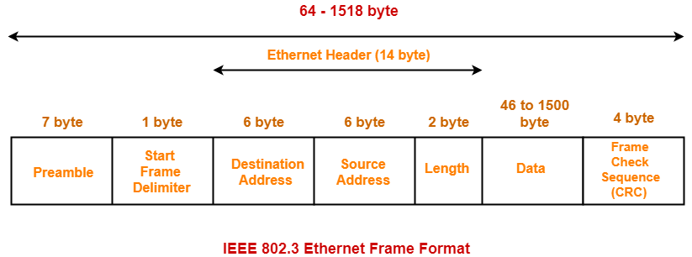
STANDARD ETHERNET
Data rate of 10 Mbps.
Characteristics
Frame Format
The Ethernet contains 7 fields.

Slide 11
STANDARD ETHERNET
Frame format
Preamble
Field contains 7 bytes (56 bits) of alternating 0s and 1s.
Actually added at the physical layer and is not part of the frame.
It alerts the receiving system to the coming frame.
Enables the frame to synchronize its clock if its out of synchronization.

Slide 12
STANDARD ETHERNET
Frame format
Start Frame Delimiter (SFD)
This field signals the beginning of the frame.
1 byte (10101011)
The SFD warns the stations, that this is the last chance for synchronization.
The last 2 bits alerts the receiver that the next field is the destination address.
Also added at the physical layer.

Slide 13
STANDARD ETHERNET
Frame format
Destination Address (DA)
This field is 6 bytes (48 bits)
Contains the link layer address of the destination.

Slide 14
STANDARD ETHERNET
Frame format
Source Address (SA)
This field is having 6 bytes.
Link layer address of the sender of the packet.

Slide 15
STANDARD ETHERNET
Frame format
Type
Defines the upper layer protocol whose packet is encapsulated in the frame.
The protocol can be IP, ARP and so on.

Slide 16
STANDARD ETHERNET
Frame format
Data
This field carries data encapsulated from the upper layer protocols.
Min: 46 bytes, Max: 1500 bytes.
If the data coming is more than 1500 bytes, it should be fragmented and encapsulated in more than one frame.
If it is less than 46 bytes, it needs to be padded with extra 0s.
Padding will be removed by the upper layer.
The upper layer protocol needs to know the length of the data.

Slide 17
STANDARD ETHERNET
Frame format
CRC
Contains error correction detection information.
If the receiver calculates the CRC and finds that it is not zero, it discards the frame.

Slide 18
STANDARD ETHERNET
Frame Length
There are restrictions on both minimum and maximum length.
The minimum is required for the correct operation of CSMA/CD.
Minimum length: 512 bits or 64 bytes.
Part of this length is the header and trailer.

Slide 19
STANDARD ETHERNET
Frame Length
If we count 18 bytes of header and trailer, then the minimum length of data from the upper layer is 64 – 18 = 46 bytes.
If the upper layer packet is less than 46 bytes, padding is added to make up the difference.
The standard defines the maximum length of the frame as 1518 bytes.
If we subtract the 18 bytes of header and trailer, the maximum length of the payload is 1500 bytes.

Slide 20
STANDARD ETHERNET
Addressing
Each station on an Ethernet network has its own network interface card (NIC).
NIC is fixed inside the station and provides a link-layer address.
The Ethernet address is 6 bytes (48 bits).
Normally written in hexadecimal notation.
4A:30:10:21:10:1A

Slide 21
STANDARD ETHERNET
Addressing
Transmission of address bits:
The transmission is left to right, byte by byte.
The LSB is sent first, and the MSB sent last.
Unicast, Multicast and Broadcast addresses:
A source address is always a unicast address. Because the frame comes from only one station.

Slide 22
STANDARD ETHERNET
Addressing
Unicast, Multicast and Broadcast addresses:
The destination address however can be, unicast, multicast or broadcast.
If the LSB of the first byte in a destination address is 0, the address is unicast. Otherwise it is multicast.
For broadcast, it will be forty-eight 1s.

Slide 23
STANDARD ETHERNET
Addressing
Distinguish between Unicast, Multicast and Broadcast Transmission:
Standard Ethernet uses a coaxial cable or a set of twisted pair cables with a HUB.
The transmission in Ethernet is always broadcast, no matter if the intention is unicast, multicast or broadcast.

Slide 24
STANDARD ETHERNET
Addressing
Distinguish between Unicast, Multicast and Broadcast Transmission:
In a unicast transmission, all stations will receive the frame, the intended recipient keeps and handles the frame; the rest discard it.
In a multicast transmission, all stations will receive the frame, the stations that are members of the group keep and handle it; the rest discard it.
In a broadcast transmission, all stations (except the sender) will receive the frame and all stations (except the sender) keep and handle it.

Slide 25
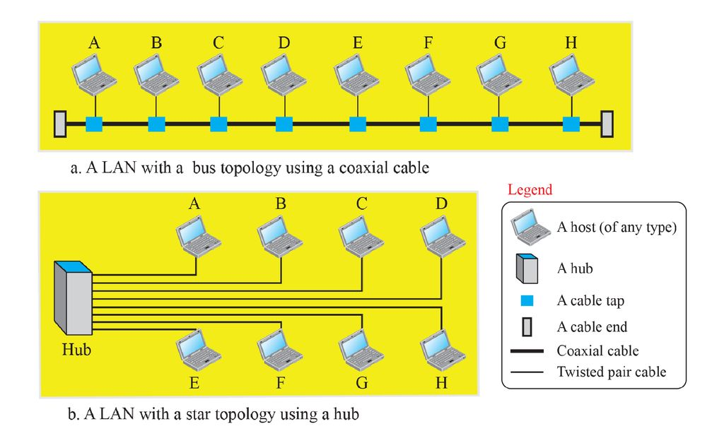
STANDARD ETHERNET
Access Method
The standard Ethernet chooses CSMA/CD with 1-persistent method.

Slide 26
STANDARD ETHERNET
Access Method

Slide 27
UNICAST ROUTING
If a datagram is destined for only one destination (one-to-one delivery) , we have unicast routing.
Routing Tables.
A packet is routed, hop by hop, from its source to destination by the help of forwarding tables.

Slide 28
UNICAST ROUTING
To find the best route, an internet can be modelled as a graph.
A set of nodes and edges that connect the nodes.
Router – As a node
Each network between two nodes – As an edge.

Slide 29
UNICAST ROUTING
Least cost routing
Total cost for the route is the least cost among all possible routes.
This means that, each router needs to find the least cost route between itself and all the other routers to be able to route a packet using this criteria.

Slide 30
UNICAST ROUTING
Least-Cost Trees
There are N routers in an internet.
There are (N – 1) least cost paths from each router to any other router.
Means we need N x (N – 1) least cost paths for the whole internet.
Better way to find the least cost path is, Least-Cost Trees.

Slide 31
UNICAST ROUTING
Least-Cost Trees
A tree with source router as the root that spans the whole graph (visits all other nodes) and in which the path between the route and any other node is the shortest.

Slide 32
ROUTING ALGORITHMS
Distance Vector Routing
A distance vector routing algorithm operates by having each router maintain a table (i.e., a vector) giving the best known distance to each destination and which link to use to get there.
These tables are updated by exchanging information with the neighbours.
Eventually, every router knows the best link to reach each destination.

Slide 33
ROUTING ALGORITHMS
Bellman-Ford Equation
Used to find the least cost (shortest distance) between a source node x and a destination node y, through some intermediary nodes (a, b, c, etc.).
D_{xy} = min { ( c_{xa} + D_{ay} ), (c_{xb} + D_{by}), (c_{xc} + D_{cy} ), ....}
Where D_{ij} is the shortest distance;
C_{ij} is the cost between the nodes i and j

Slide 34
ROUTING ALGORITHMS
Bellman-Ford Equation
In distance vector routing, each router maintains a routing table indexed by, and containing one entry for each router in the network.
This entry has two parts:
The preferred outgoing line to use for that destination.
An estimate of the distance to that destination.
The distance might be measured as the number of hops or using another metric, as we discussed for computing shortest paths.

Slide 35
ROUTING ALGORITHMS
The router is assumed to know the ‘‘distance’’ to each of its neighbours.
If the metric is hops, the distance is just one hop.
If the metric is propagation delay, the router can measure it directly with special ECHO packets that the receiver just timestamps and sends back as fast as it can.

Slide 36
ROUTING ALGORITHMS
Bellman-Ford Equation
Information kept by DV router
Each router has an ID
Associated with each link connected to a router, there is a link cost (static or dynamic).
Intermediate hops
Distance Vector Table Initialization
Distance to itself = 0
Distance to ALL other routers = infinity number.

Slide 37
ROUTING ALGORITHMS
Routing Table
1
B
A
9
Destination | Cost | Next Hop
A | 1 | A
C | 3 | C
E | 9 | E
3
5
E
C
2
4
D
Initial Routing Table of B

Slide 38
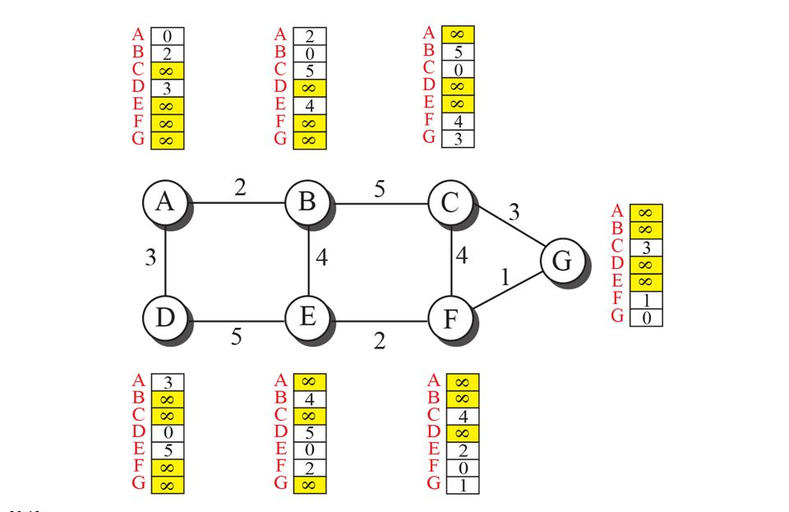
ROUTING ALGORITHMS

Slide 39
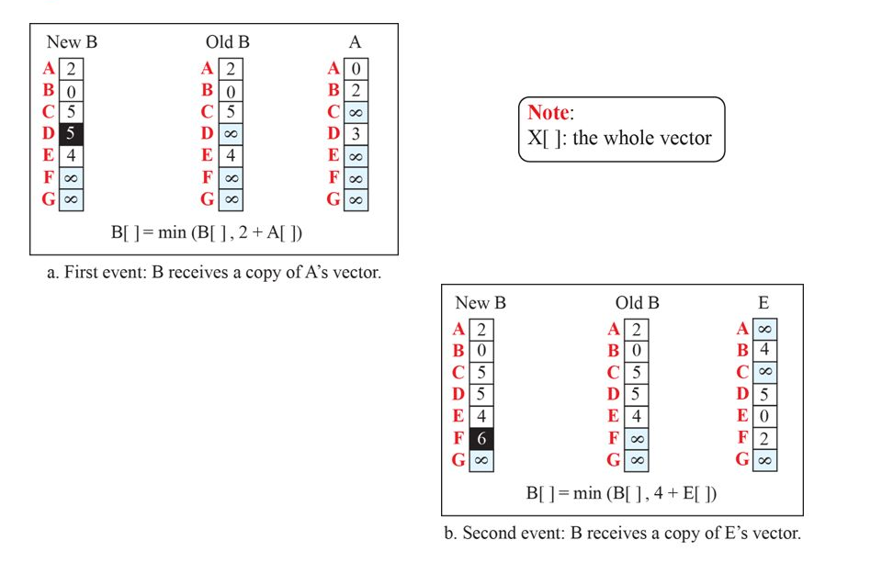
ROUTING ALGORITHMS

Slide 40
LINK-STATE ROUTING
Distance vector routing was used in the ARPANET until 1979, when it was replaced by link state routing.
The primary problem that caused its demise was that the algorithm often took too long to converge after the network topology changed.
Variants of link state routing called IS-IS and OSPF are the routing algorithms that are most widely used inside large networks and the Internet today.

Slide 41
LINK-STATE ROUTING
The idea behind link state routing is fairly simple and can be stated as five parts.
Each router must do the following things to make it work:
Discover its neighbors and learn their network addresses.
Set the distance or cost metric to each of its neighbors.
Construct a packet telling all it has just learned.
Send this packet to and receive packets from all other routers.
Compute the shortest path to every other router.

Slide 42
LINK-STATE ROUTING
In effect, the complete topology is distributed to every router.
Then Dijkstra’s algorithm can be run at each router to find the shortest path to every other router.

Slide 43
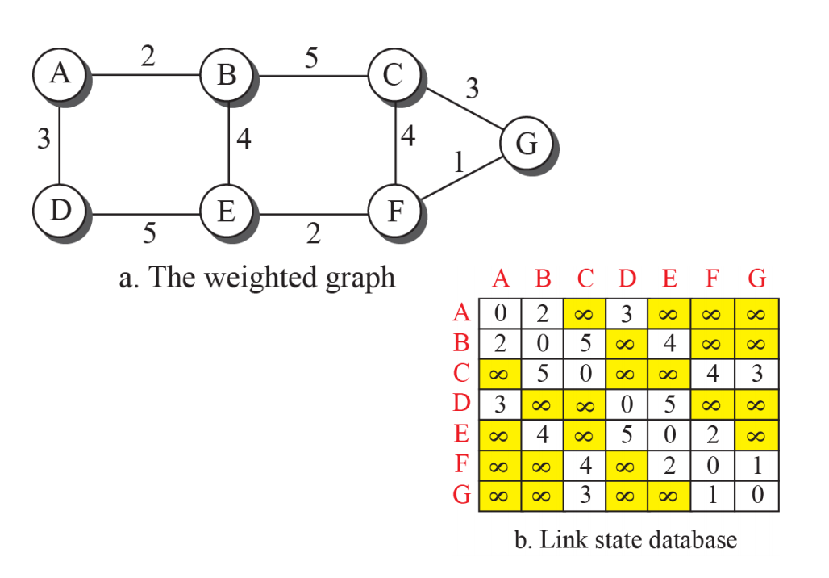
LINK-STATE ROUTING
LSDB (Least Cost DataBase)

Slide 44
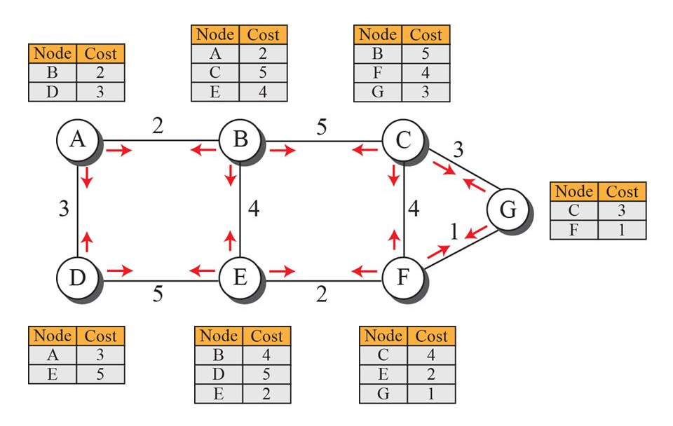
LINK-STATE ROUTING
LSDB (Least Cost DataBase)

Slide 45
LINK-STATE ROUTING
Least-Cost Trees
Created using Dijkstra’s Algorithm.
Steps:
The node chooses itself as the root node of the tree.
The node selects one node, among all nodes in the tree, which is closest to the root, and adds this to the tree. After this node is added to the tree, the cost of all other nodes not in the tree needs to be updated because the paths may have been changed.
The node repeats step 2 until all nodes are added to the tree.

Slide 46
PATH VECTOR ROUTING
Both previous protocols were based on least cost method.
To overcome the disadvantages of both LS and DV, Path Vector routing came in to existence.
Here, the best route is selected by the source using the policy it imposes on the route.
That means, the source can control the path.

Slide 47
PATH VECTOR ROUTING
Spanning Trees
The path is determined by the best spanning tree.
It is not the least cost tree.
It is the tree determined by the source when it imposes its own policy.

Slide 48
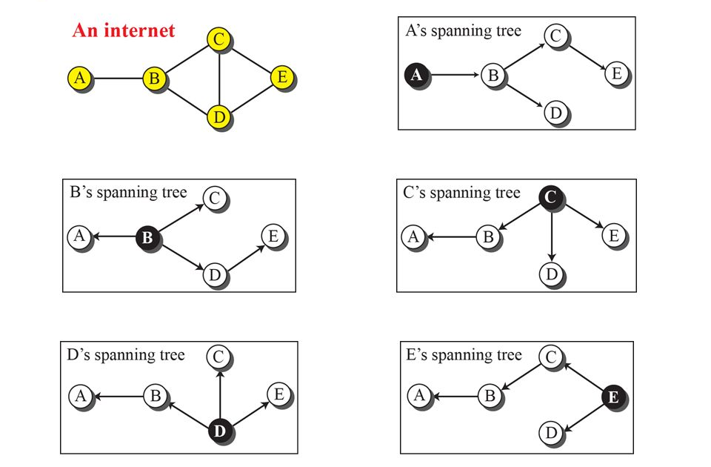
PATH VECTOR ROUTING
Spanning Trees

Slide 49
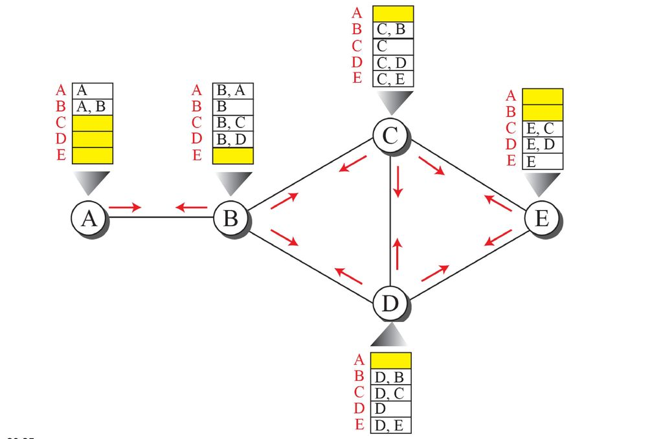
PATH VECTOR ROUTING
Spanning Trees

Slide 50
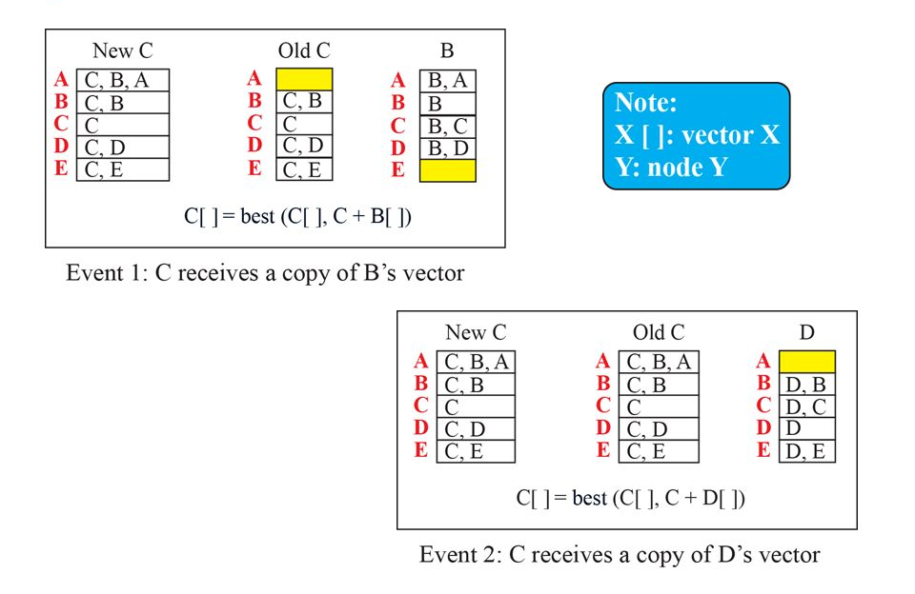
PATH VECTOR ROUTING

Slide 51
IPV4 ADDRESSES
IP Address: It is an identifier, which is used to identify the connection of each device to the internet.
It's a 32 bit address that uniquely and universally defines the connection of a host or a router to the internet.
It is the address of the connection, not the host or the router.
If the device is moved to another network, the IP address may be changed.

Slide 52
IPV4 ADDRESSES
IPV4 address are unique in the sense, that each address defines one and only one, connection to the internet.
If a device has two connections to the internet, via two networks, it has two IPV4 addresses.
IPV4 addresses are universal in the sense that the addressing system must be accepted by any host that wants to be connected to the internet.

Slide 53
IPV4 ADDRESSES
Address Space
A protocol like IPV4 that defines addresses has an address space.
An address space is the total number of addresses used by the protocol.
If a protocol uses b bits to define an address, the address space is 2^{b} because each bit can have two different values (0 or 1).
IPV4 uses 32 bit addresses, which means that the address space is 2³² or 4,294,967,296 (more than four billion).

Slide 54
IPV4 ADDRESSES
Notation
There are three common notations to show an IPV4 address:
Binary notation( base 2 )
Dotted-decimal notation (base 256)
Hexadecimal notation (base 16)

Slide 55
IPV4 ADDRESSES
Notation
In binary notation – it is displayed as 32 bits.
Each octet is referred to as a byte.
To make the IPV4 more compact and easier to read, it is usually written in decimal form with a decimal point separating the bytes.
This format is known as dotted-decimal notation.

Slide 56
IPV4 ADDRESSES
Notation
Note that because each byte is only 8 bits (octet), each number in the dotted-decimal notation is between 0 and 255.
We sometimes see an IPV4 in hexadecimal notation.
Each hexadecimal digit is having 4 bits.
This means that a 32 bit address has 8 hexadecimal digits.
This notation is often used in network programming.

Slide 57
IPV4 ADDRESSES
Notation
Note that because each byte is only 8 bits (octet), each number in the dotted-decimal notation is between 0 and 255.
We sometimes see an IPV4 in hexadecimal notation.
Each hexadecimal digit is having 4 bits.
This means that a 32 bit address has 8 hexadecimal digits.
This notation is often used in network programming.

Slide 58
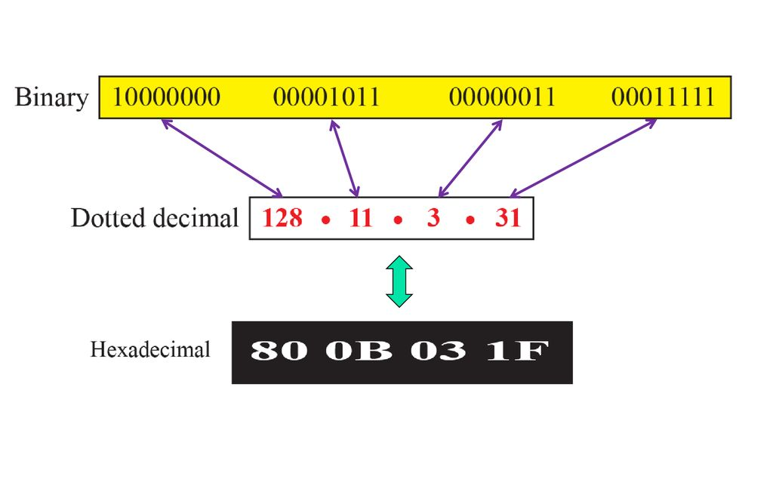
IPV4 ADDRESSES

Slide 59
IPV4 ADDRESSES
Hierarchy in addressing
The addressing system is hierarchical.
A 32 bit IPV4 address is divided into two parts:
Prefix and suffix
Prefix defines the network and suffix defines the node.
The network identifier in the IPV4 was first designed as a fixed-length prefix, and is referred to as classful addressing.
The new scheme, which is referred to as classless addressing, uses a variable length network prefix.

Slide 60
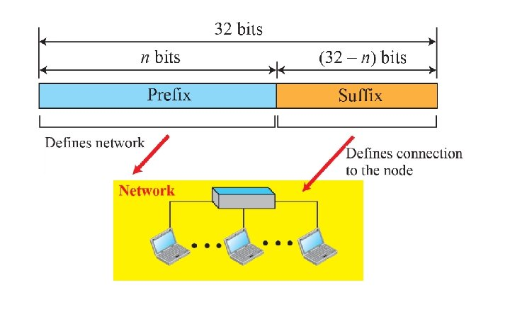
IPV4 ADDRESSES

Slide 61
IPV4 ADDRESSES
CLASSFUL ADDRESSING
When internet started, the IPV4 address was designed with a fixed length prefix.
But to accommodate both small and large networks, three fixed-length prefixes were designed instead of one. (n = 8, n = 16, and n = 24).
The whole address space was divided into five classes.
CLASS A, CLASS B, CLASS C, CLASS D and CLASS E
This scheme is referred to as classful addressing.

Slide 62
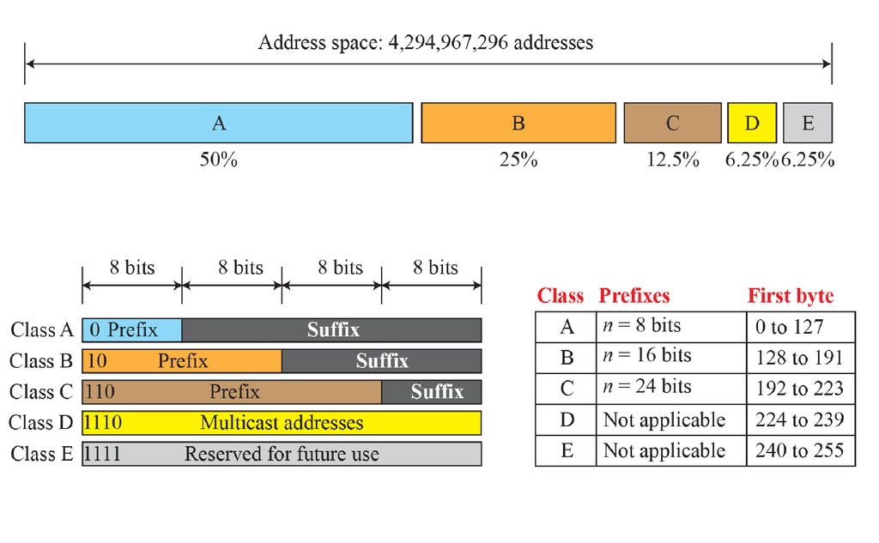
IPV4 ADDRESSES
CLASSFUL ADDRESSING

Slide 63
IPV4 ADDRESSES
CLASSLESS ADDRESSING
Subnetting and supernetting in classful addressing did not really solve the address depletion problem.
With the growth of the internet, it was clear that a larger address space was needed as a long term solution.
The larger address space, however, requires that the length of IP addresses also be increased.
It means that the format of the Ip Packets needs to be changed.

Slide 64
IPV4 ADDRESSES
CLASSLESS ADDRESSING
The short term solution for solving this problem was called as classless addressing.
In other words, the class privilege was removed from the distribution to compensate for the address depletion.
In classless addressing variable length blocks are used that belong to no classes.

Slide 65
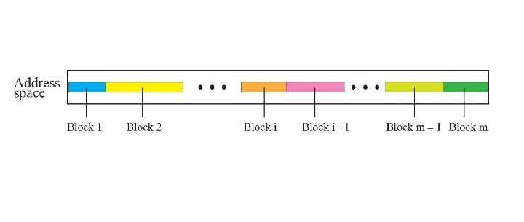
IPV4 ADDRESSES
CLASSLESS ADDRESSING

Slide 66
INTERNET PROTOCOL (IP)
The network layer in version 4 can be thought of as one main protocol and three auxiliary ones.
the main protocol, internet protocol version 4 (IPV4), is responsible for packetizing, forwarding and delivery of a packet at the network layer.
The ICMPv4 helps IPv4 to handle some errors that may occur in the network layer delivery.
The IGMP is used to help IPv4 in multicasting.
The ARP is used to glue the network and data-link layers in mapping network layer addresses to link-layer addresses.

Slide 67
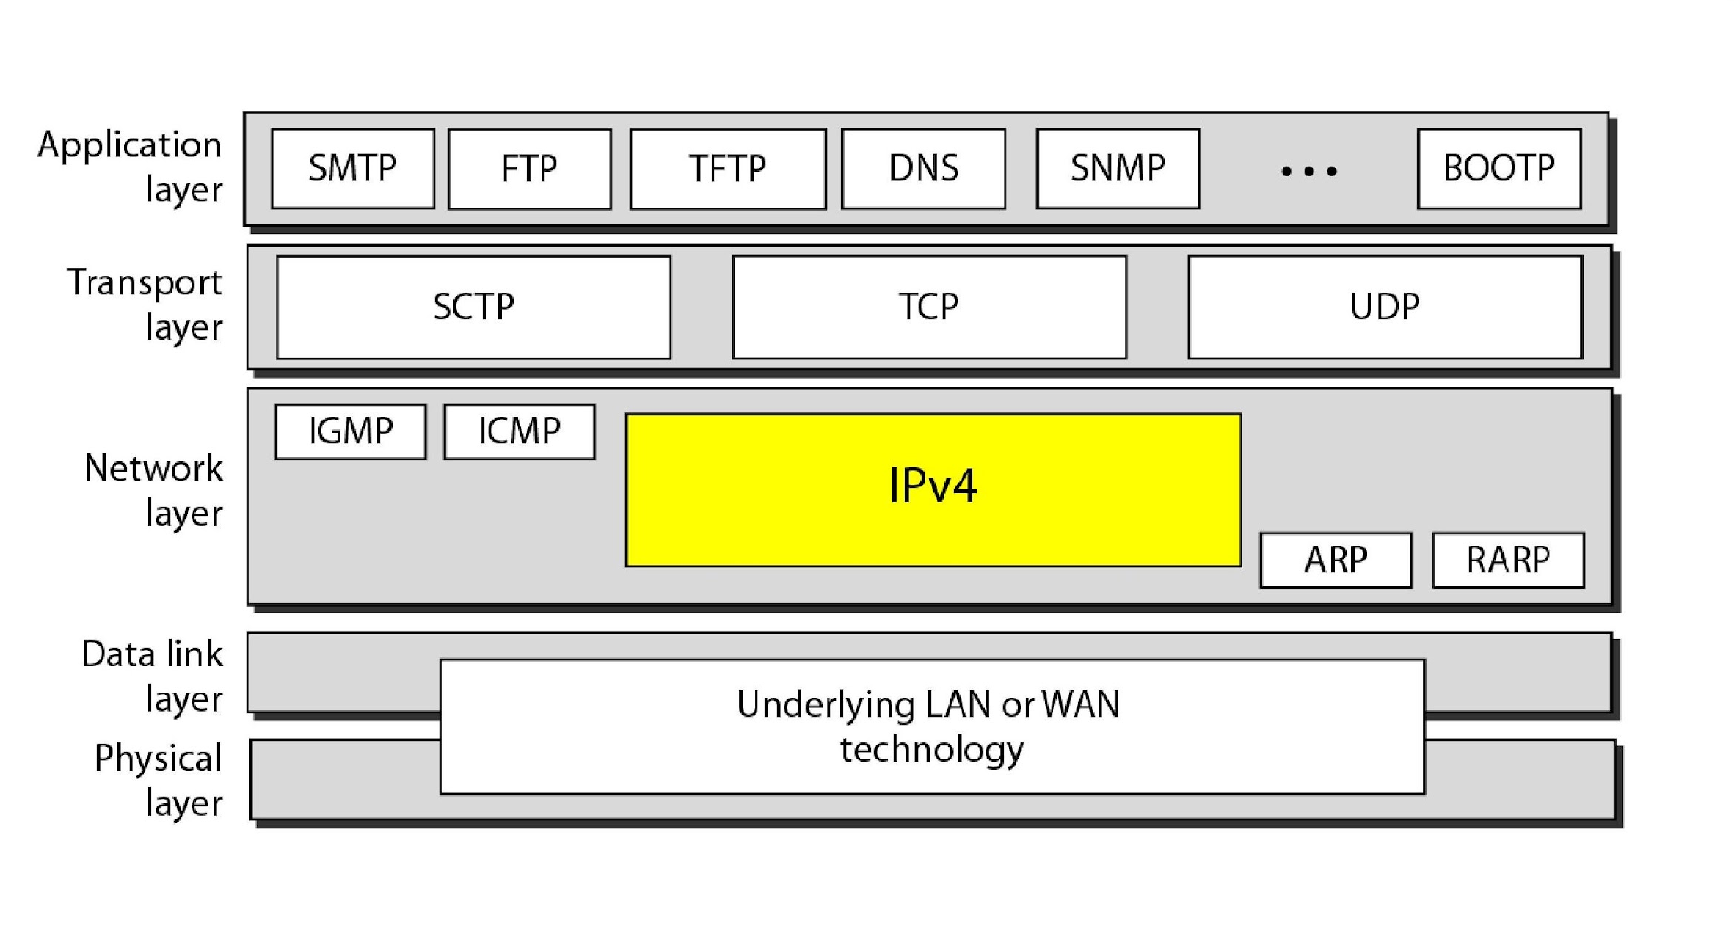
INTERNET PROTOCOL (IP)

Slide 68
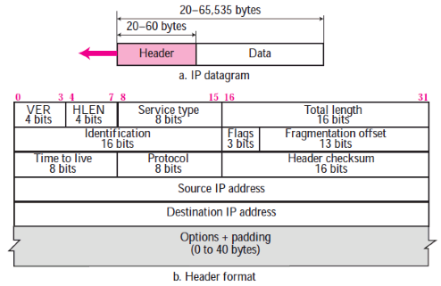
INTERNET PROTOCOL (IP)
DATAGRAM FORMAT

Slide 69
INTERNET PROTOCOL (IP)
SUBNETTING
A sub-network or subnet is a logical subdivision of an IP network.
In Subnetting we create multiple small manageable networks from a single large IP network.
The practice of dividing a network into two or more networks is called subnetting.

Slide 70
INTERNET PROTOCOL (IP)
SUBNETTING
To best utilize available addresses if we put more than 16000000 hosts in a single network, due to broadcast and collision, that network will never work.
If we put less hosts then remaining addresses will be wasted. Subnetting provides a better way to deal with this situation.
Subnetting allows us to create smaller networks from a single large network which not only fulfill our hosts’ requirement but also offer several other networking benefits.

Slide 71
INTERNET PROTOCOL (IP)
SUBNETTING

